Slide 1
Strategies for Poker AI player
Research Paper: Computer Poker by Darse Billings Dept. of CS, University of Alberta
5/2/17

Slide 2
Why study Poker?
Bluff and Poker are similar in that, at any stage the players only have partial knowledge about the current state of the game.
Incomplete or unreliable knowledge and risk management are factors that make Poker an interesting study for our project.
The Computer Poker Research Group (CPRG) of the University of Alberta has contributed greatly towards the study of poker academically.
The implemented a neural network for predicting the opponent's next move

Slide 3
Optimal move
Koller in his paper "Generating and solving imperfect information games" states that just as there is an optimal move for every perfect information game, existence of optimal strategies can be proved if randomized strategies are allowed.
Optimal strategy ensures that the opponent gains no advantage over the player even if his strategy is revealed
The theoretical maximum guaranteed profit from a given poker situation can be attained by bluffing, or calling a possible bluff, with a predetermined probability

Slide 4
Poker example
Consider an example with 2 players in a game of pot-limit Draw poker where player 2 has called a flush with a draw of just one card against player 1 who has the best hand.
Player 2 wins showdown (revealing of cards played) if she makes the flush, but loses otherwise.
This situation is similar to when an opponent calls bluff and the player has to display the cards.
If the cards are played right, the player is safe, but otherwise he loses and has to take the pile.

Slide 5
Poker example contd.
The example further assumes that the probability of completing the flush is exactly 0.2 or one in five, since 5 cards make a flush.
Game theoretic analysis can be used to calculate the number of bluffs and the numbers of calls that helps to build an optimal strategy.
For each pair of frequencies, the overall expectation can be calculated as shown in the following Table.

Slide 6
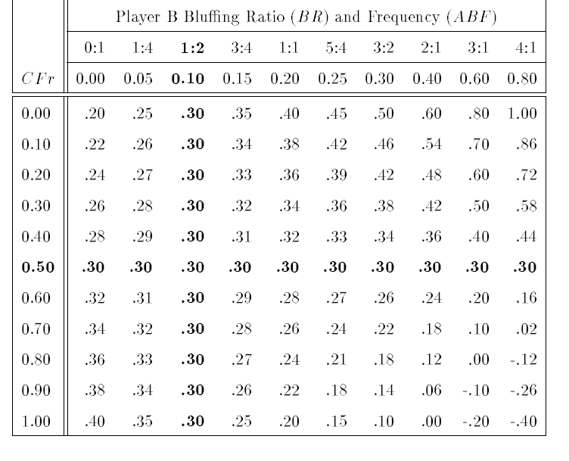
Table: expected values for a 4-flush draw in Poker
BR = Ratio of Bluffs to Legitimate bets
ABF = Absolute Bluff Frequency
CFr = Absolute Calling Frequency

Slide 7
Optimal Strategies in Poker
From table, to obtain the guaranteed maximum, Player B should bet 30% of time.
Player A can ensure his optimal expectation of 0.7 by calling exactly 50% of the time Player B bets.
Optimal ratios will change depending on the size of the bet in relation to the pot, but is independent of other factors.

Slide 8
Strategies for Bluff
Currently we pursue the optimal strategy which can be used in Bluff as well, where we determine the probabilities of each card being in a particular hand.
We know with certainty which cards are in our hand and which cards have been played.
We determine the probability of all other cards based on cards that have been played.
To start with, we could just use a naive and equal probability that a card is in some player's hand.
If there are four players, each player have a probability of 1/39 or 0.025 to have a card, except for those cards which are held by the player himself with a probability of 1.

Slide 9
Maximal Strategies in Poker
Maximal strategy is directed towards exploiting weaknesses in opponent
Optimal strategy implicitly assumes perfect play on the part of the opponent.
Example for Maximal strategy: If faced with a bet from a player who never bluffs, strong player will fold a marginal hand.

